Slide 1
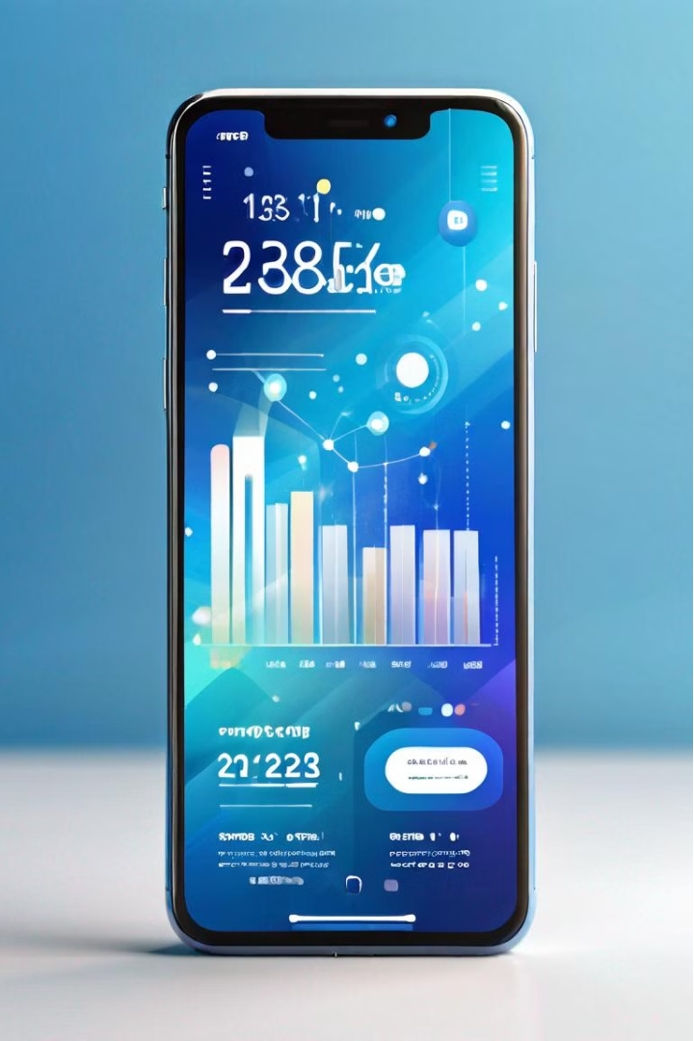

Optimizing Mobile Data Usage and Spending in Nigeria
As a mobile user in Nigeria, managing my data usage and spending can be a constant challenge. This presentation aims to provide a detailed analysis of my mobile data usage and spending behavior, enabling me to make informed decisions and optimize your data plan. By understanding my consumption patterns and identifying optimization opportunities, I can ensure I am getting the most value from your mobile data package.
By Favour Emmanuel

Slide 2
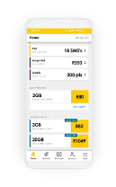
Project Case Study:
I would like to analyze and compare the costs of these plans to find the most cost-effective option and optimize my data usage behaviour.
Previous plan: 24GB for ₦3500 per month (due to double data incentive).
Current plan: 2.5GB for ₦600 every 2 days.
Considering: Bimonthly plan of 100GB for ₦20,000.

Slide 3

ASK.
Is my daily data package worth the spend?
What is my monthly Data consumption behavior?
What is the current Average Monthly spend on Data?
Which Application is the most used by Screen time?
Which Application Uses the Highest Amount of Data?
Which Category has the Highest Data Usage and Screen time?

Slide 4

Prepare.
There is a need to gather all required data from various sources.
1
The Data required to answer the above questions are to be sourced from monthly bank statement and mobile screen time usage.
2
The duration of collection is a day as this data will be manually sourced and stored in a google spread sheet.
3
Two sets of bank statement data were collected from Opay and Access Bank respectively from the 7th of may to the 7th of June, 2024

Slide 5

Process.
The gathered Data was not in the best conditions, here are some of the changes made.
1
Inconsistent values from Description column Mobile data,BILLS/ MTN DATA/07064495304 is change to '' Mobile data''
2
The Data types have been ensured to be consistent.
3
Data Aggregation was caried out on two occasions.

Slide 6
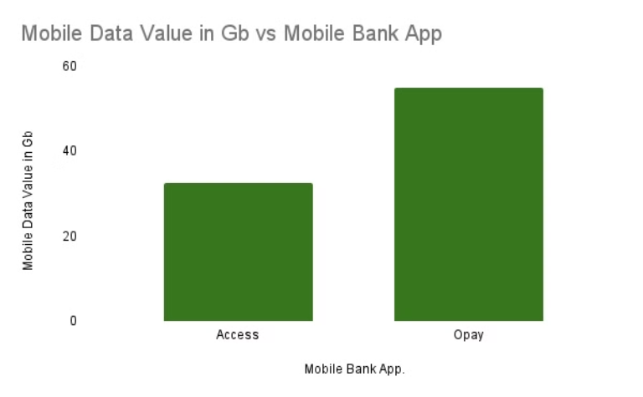


Analyze.
What is my monthly Data consumption behavior?
My total Data consumption in a month is 87.5gb.

Slide 7
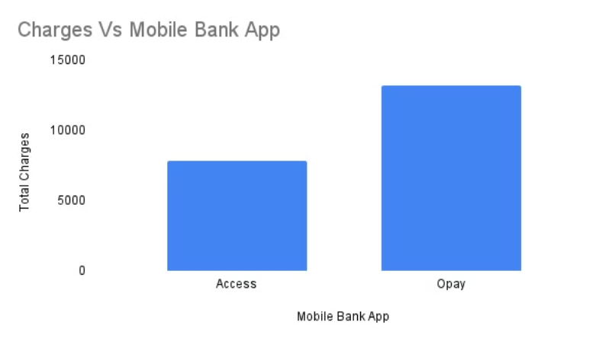
Analyze.
What is the current Average Monthly spend on Data?
My Average monthly spend on Data is ₦21,000.

Slide 8

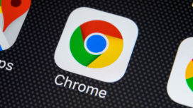
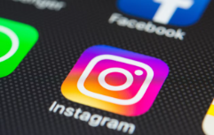
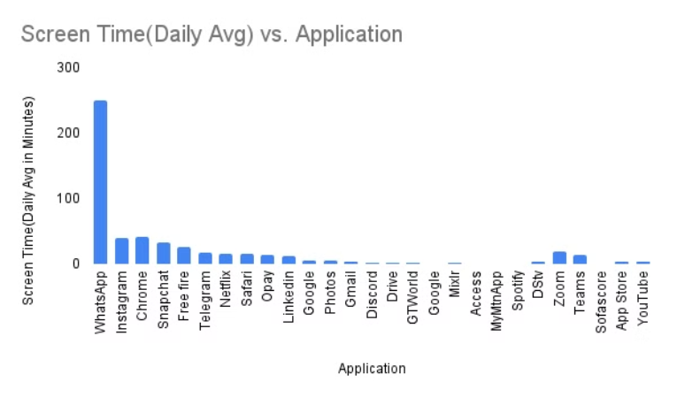
Analyze.
Which Application is the most used by Screen time?
WhatsApp, Chrome and Instagram respectively, are the most used applications by screen time.

Slide 9
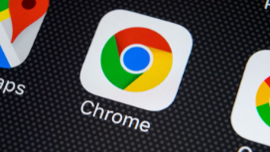
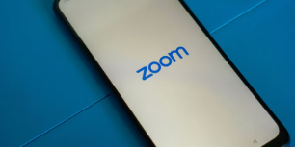
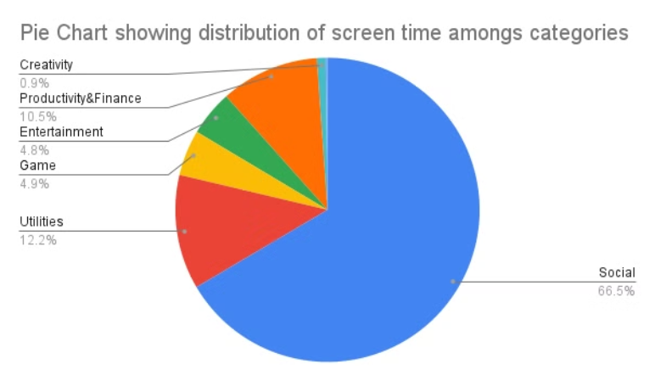
Analyze.
Which Category has the Highest Screen time?
Social has the highest screen time compared to other categories.

Slide 10


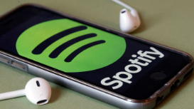
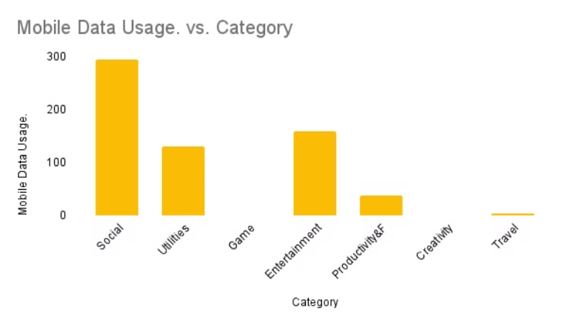
Analyze.
Which Category has the Highest Data Usage?
Social has the highest consumption rate compared to other categories.

Slide 11

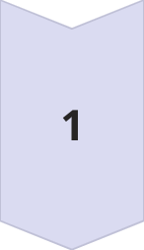
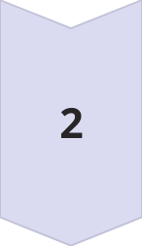
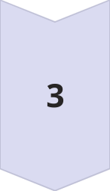
Optimizing My Mobile Data Plan
Review Usage Patterns
From the Data, it can be seen that more time is spent on social media than other categories i.e. 56% more than the next category. Reducing social media screen time would definitely result in reduction of monthly data cost.
Adjust Data Package
It can be seen that WhatsApp consumed the most data, it also has the highest amount of screen time. Specialized WhatsApp bundles would be preferable.
Implement Usage Controls
Leveraging built-in data usage controls and monitoring features on my device to set limits, receive alerts, and proactively manage your data consumption, as this helps to cut extra expenses and stay within budget

Slide 12
Conclusion: Taking Action
Optimize My Plan
Monitor and Adjust
After comparing with other bundles, I can see that a bi-monthly plan of 100gb at ₦20,000 is cheaper and of greater value than my usual 2.5gb for ₦600 which sums up a total of 87.5gb at the rate of #21,000.
Continually monitor data usage and spending, and be ready to make adjustments to my plan or usage behavior as needed. Staying vigilant and adaptable will ensure you maintain control over your mobile data expenses.
Embrace Efficiency
Celebrate Savings
Implement strategies to optimize data consumption, such as setting screen Time limit, adjusting streaming quality settings, and limiting background data usage. These small changes can lead to significant savings in the long run.
Acknowledging every little progress made due to optimization and Celebrating my newfound data optimization success!

Slide 13


